Slide 1


Planting Agent Technical Report#2
Autonomous Multiagent Systems
Course id :AI314
Instructor : Dr. Mohamed A. Wahby
Name - ID
Ahmed Kadry 20180018
Loai Gamal 20180206
Mohamed Sayed 20180224
Marina Moheb 20180208
22 MAY - Spring 2021

Slide 2
Formulate the problem precisely
what is our problem?
what is our problem type of formulation ?
the problem is in sowing the seeds.
incremental formulation

Slide 3
Formulate the problem precisely
Formulation:
States
Initial states
Actions
Transition states
Goal test
Position of the robot.
Bucket of the seeds is empty or not.
The soil seeded or not.
Start of line.
Bucket of seeds is not empty.
The soil not seeded.
Move forward on the line.
Fill the bucket of the seeds if it empty.
Dig the soil to make it okay for seeding.
Seeded the soil by the seeds.
When it complete seeding in the soil on the hole line.
End of the line.
Bucket of seeds is not empty.
The soil is seeded.

Slide 4
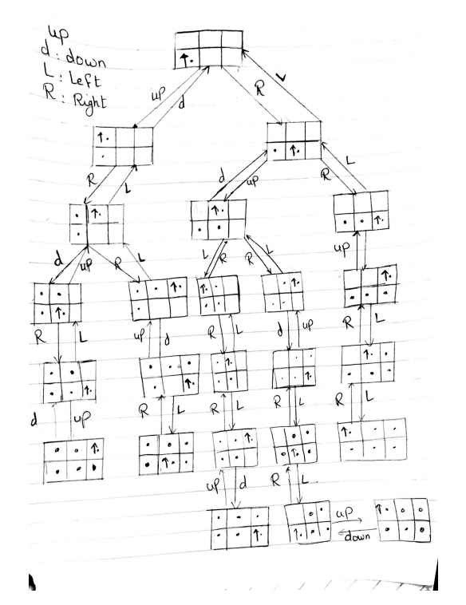
Diagram of the complete state space

Slide 5
The problem using two different search algorithms
1-

Slide 6
The problem using two different search algorithms
2-

